Slide 1
The LuGre Friction Model

Slide 2
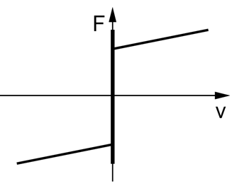
Friction Components
Break-away (stiction)
Columb
Viscous
nonlinear
linear
Sticition
Viscous
Columb

Slide 3
Static vs Dynamic Friction Models
Dynamic Friction | Static Friction
Dahl | Karnopp
LuGre
What are the differences?

Slide 4
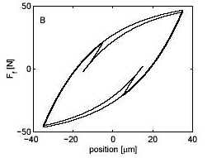
Hysteresis Loop
What makes hysteresis?
Can you demonstrate this with MATLAB?
http://people.mech.kuleuven.be/~farid/tribology/friction/comp/FF/machine_results/machine_results.htm

Slide 5
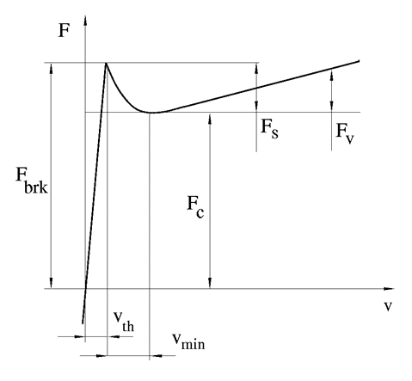
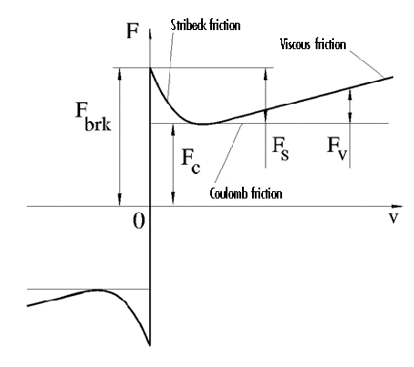
Stribeck Curve
discontinuous
continuous
http://ch.mathworks.com/help/physmod/simscape/ref/translationalfriction.html

Slide 6

Stribeck Curve
$v_{TH}$ : linear region velocity threshold (from 1e-4 to 1e-6 m/s)
$F_{c}$ = Columb friction
$F_{br}$= Stiction friction / break-away friction
$F_{v}$ = Viscous friction

Slide 7
Implementation - MATLAB
Linearized dynamics around the pre-sliding regime:

